Slide 1
Why InDesign?
If I know how to use Illustrator and Photoshop,
Why do I need InDesign

Slide 2
What is InDesign?
According to Adobe, InDesign is the industry-leading layout and page design software for print and digital media.
Create beautiful graphic designs with typography from the world՚s top foundries and imagery from Adobe Stock.
Quickly share content and feedback in PDF.
Easily manage production with Adobe Experience Manager.
InDesign has everything you need to create and publish books, digital magazines, eBooks, posters, interactive PDFs, and more.

Slide 3
Use the right tool for the job
Illustrator – Logo and icon design, hard-edged graphic illustrations, graphic charts
Photoshop – Editing and color correcting images, compositing images, soft special effects and illustrations, removing or changing backgrounds from images
InDesign – Page layout for printed and electronic documents that include photos, graphics and text, especially multiple page documents

Slide 4
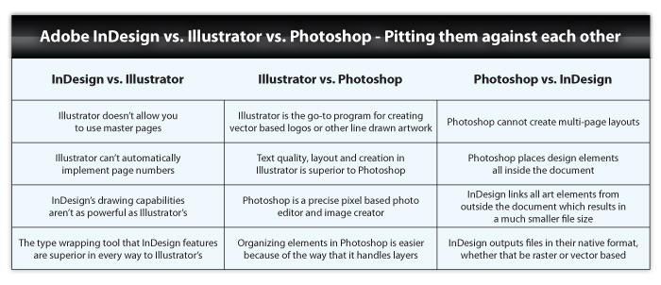
Let’s compare them

Slide 5
When to use Illustrator
Vector based illustration, such as logos, icons etc.
Scalable graphics without resolution concerns
Simple, single page documents that rely heavily on vector graphics and text – Illustrator does not have master pages, automatic page numbering or imposition capabilities

Slide 6
When to use Photoshop
Enhancing images for print
Compositing images and adding special effects
Raster-based illustrations
Web graphics, such as website layouts, banner ads and GIF creation
Simple 3D illustrations, simple video and anmimations

Slide 7
NEVER use Photoshop for:
Logos should never be designed in Photoshop – resolution dependent
Setting up type for print documents – Photoshop is the weakest type application of the group and the type is raster based, making it less sharp and clear

Slide 8
When to use InDesign
Any document that include images and text that will be printed
Multiple page documents, especially ones with page numbers and common page graphics and positioning
Documents where text wrapping, color management, common text attributes, lots of text are used
When PDF files are needed for web and print docuemnts

Slide 9
Use all three together
Bring vector graphics from Illustrator, and raster images from Photoshop into InDesign documents
InDesign can help manage updates and will output the placed graphics in their native versions

